Slide 1
Smart alarm
clock
Цветомир Стайков
2 курс КН
1MI0800469

Slide 2
Smart alarm
Цветомир Стайков
2 курс КН
1MI0800469
clock

Slide 3
Smart alarm
In this presentation:
Inspiration
Hardware and electronics design
Code and architecture
Demo
Цветомир Стайков
2 курс КН
1MI0800469
clock

Slide 4

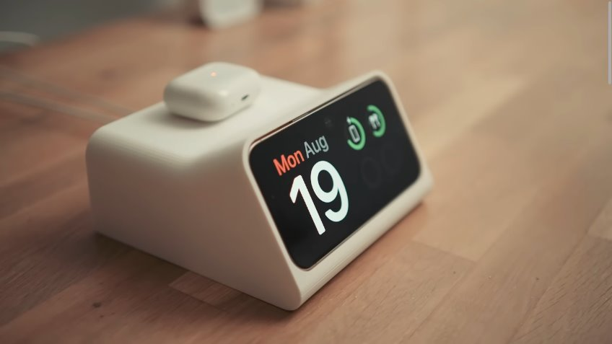
phone app for tracking sleep
Standby dock for Iphone
by Scott Yu-Jan and OVERWERK

Slide 5
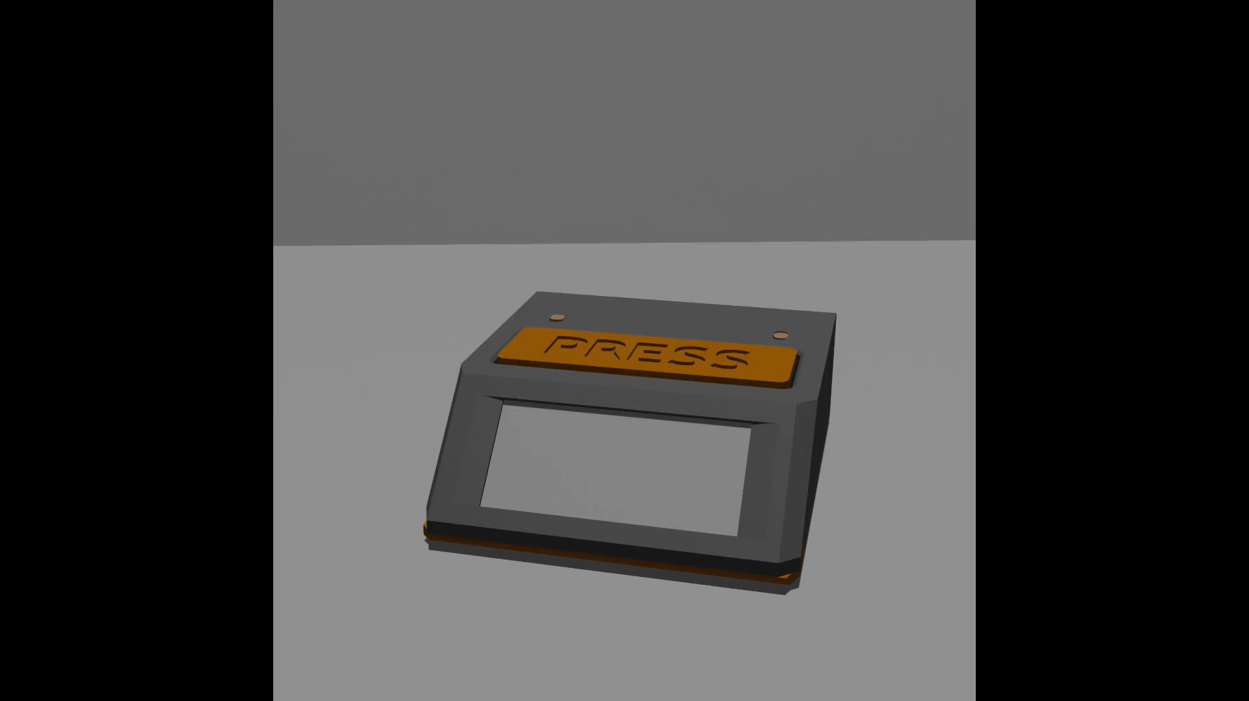

Slide 6
3d принтиран дизайн
Материал:
PLA оранжево & сиво
Време за принтиране:
~ 6 часа + тестове
Време за разработка:
~ 2 дена

Slide 7
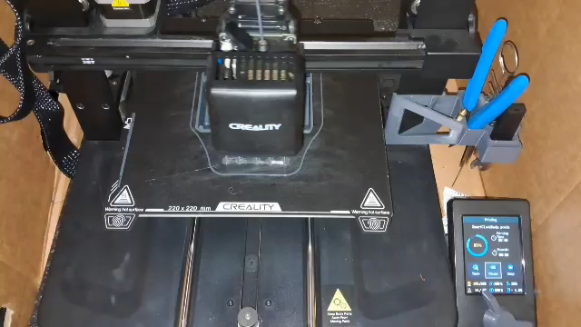
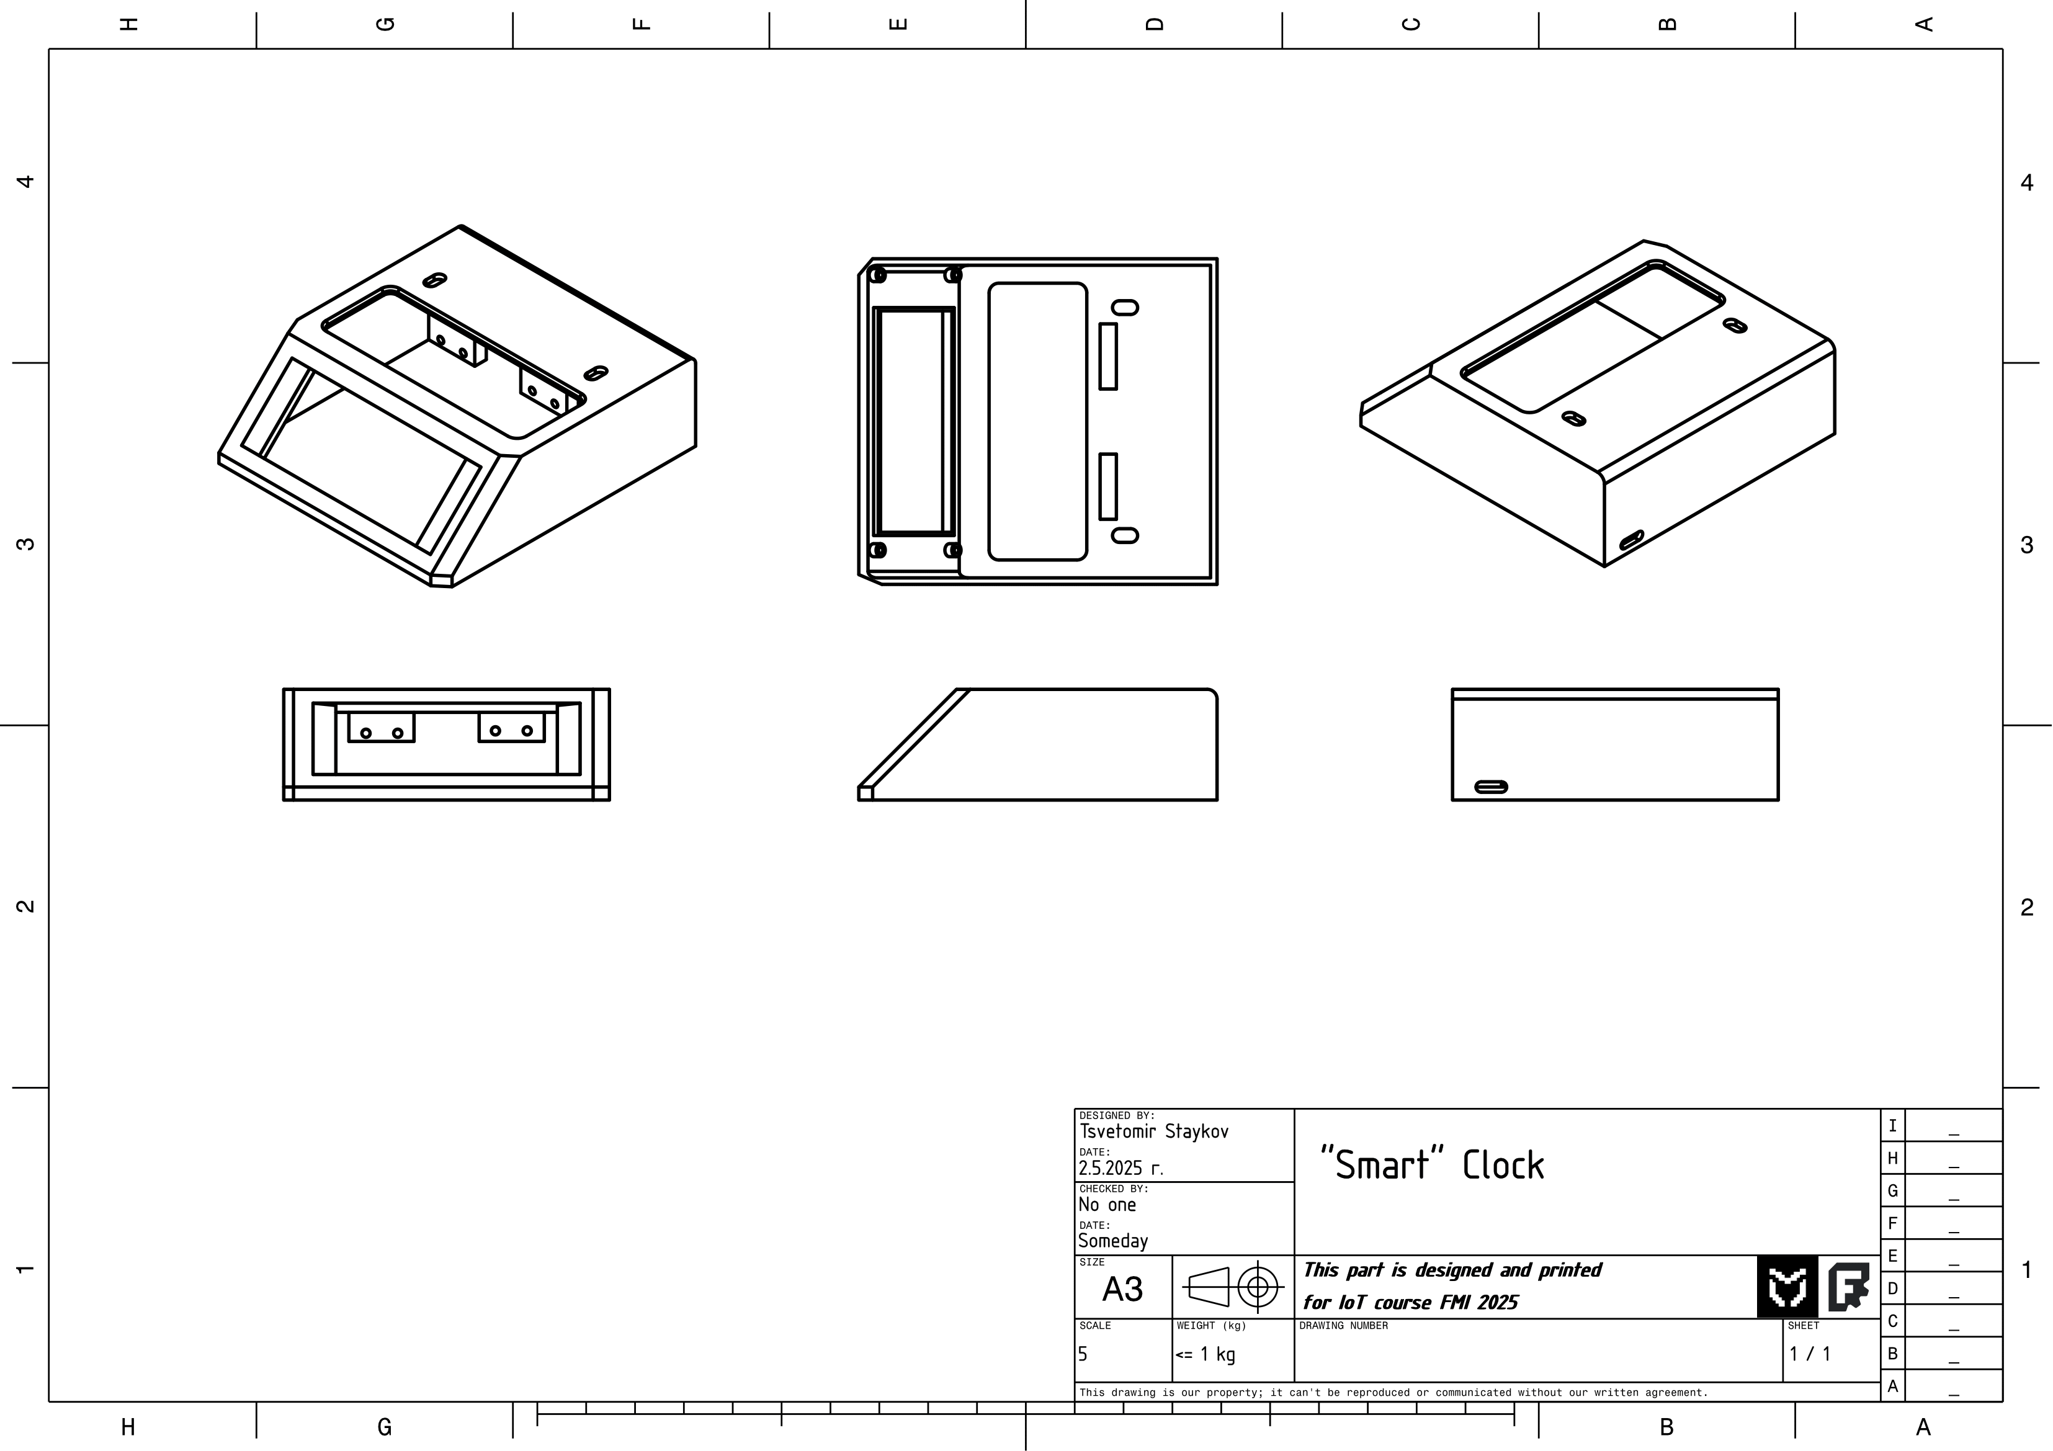

Slide 9
3d принтиран дизайн
Материал:
PLA оранжево & сиво
Време за принтиране:
~ 6 часа + тестове
Време за разработка:
~ 2 дена

Slide 11
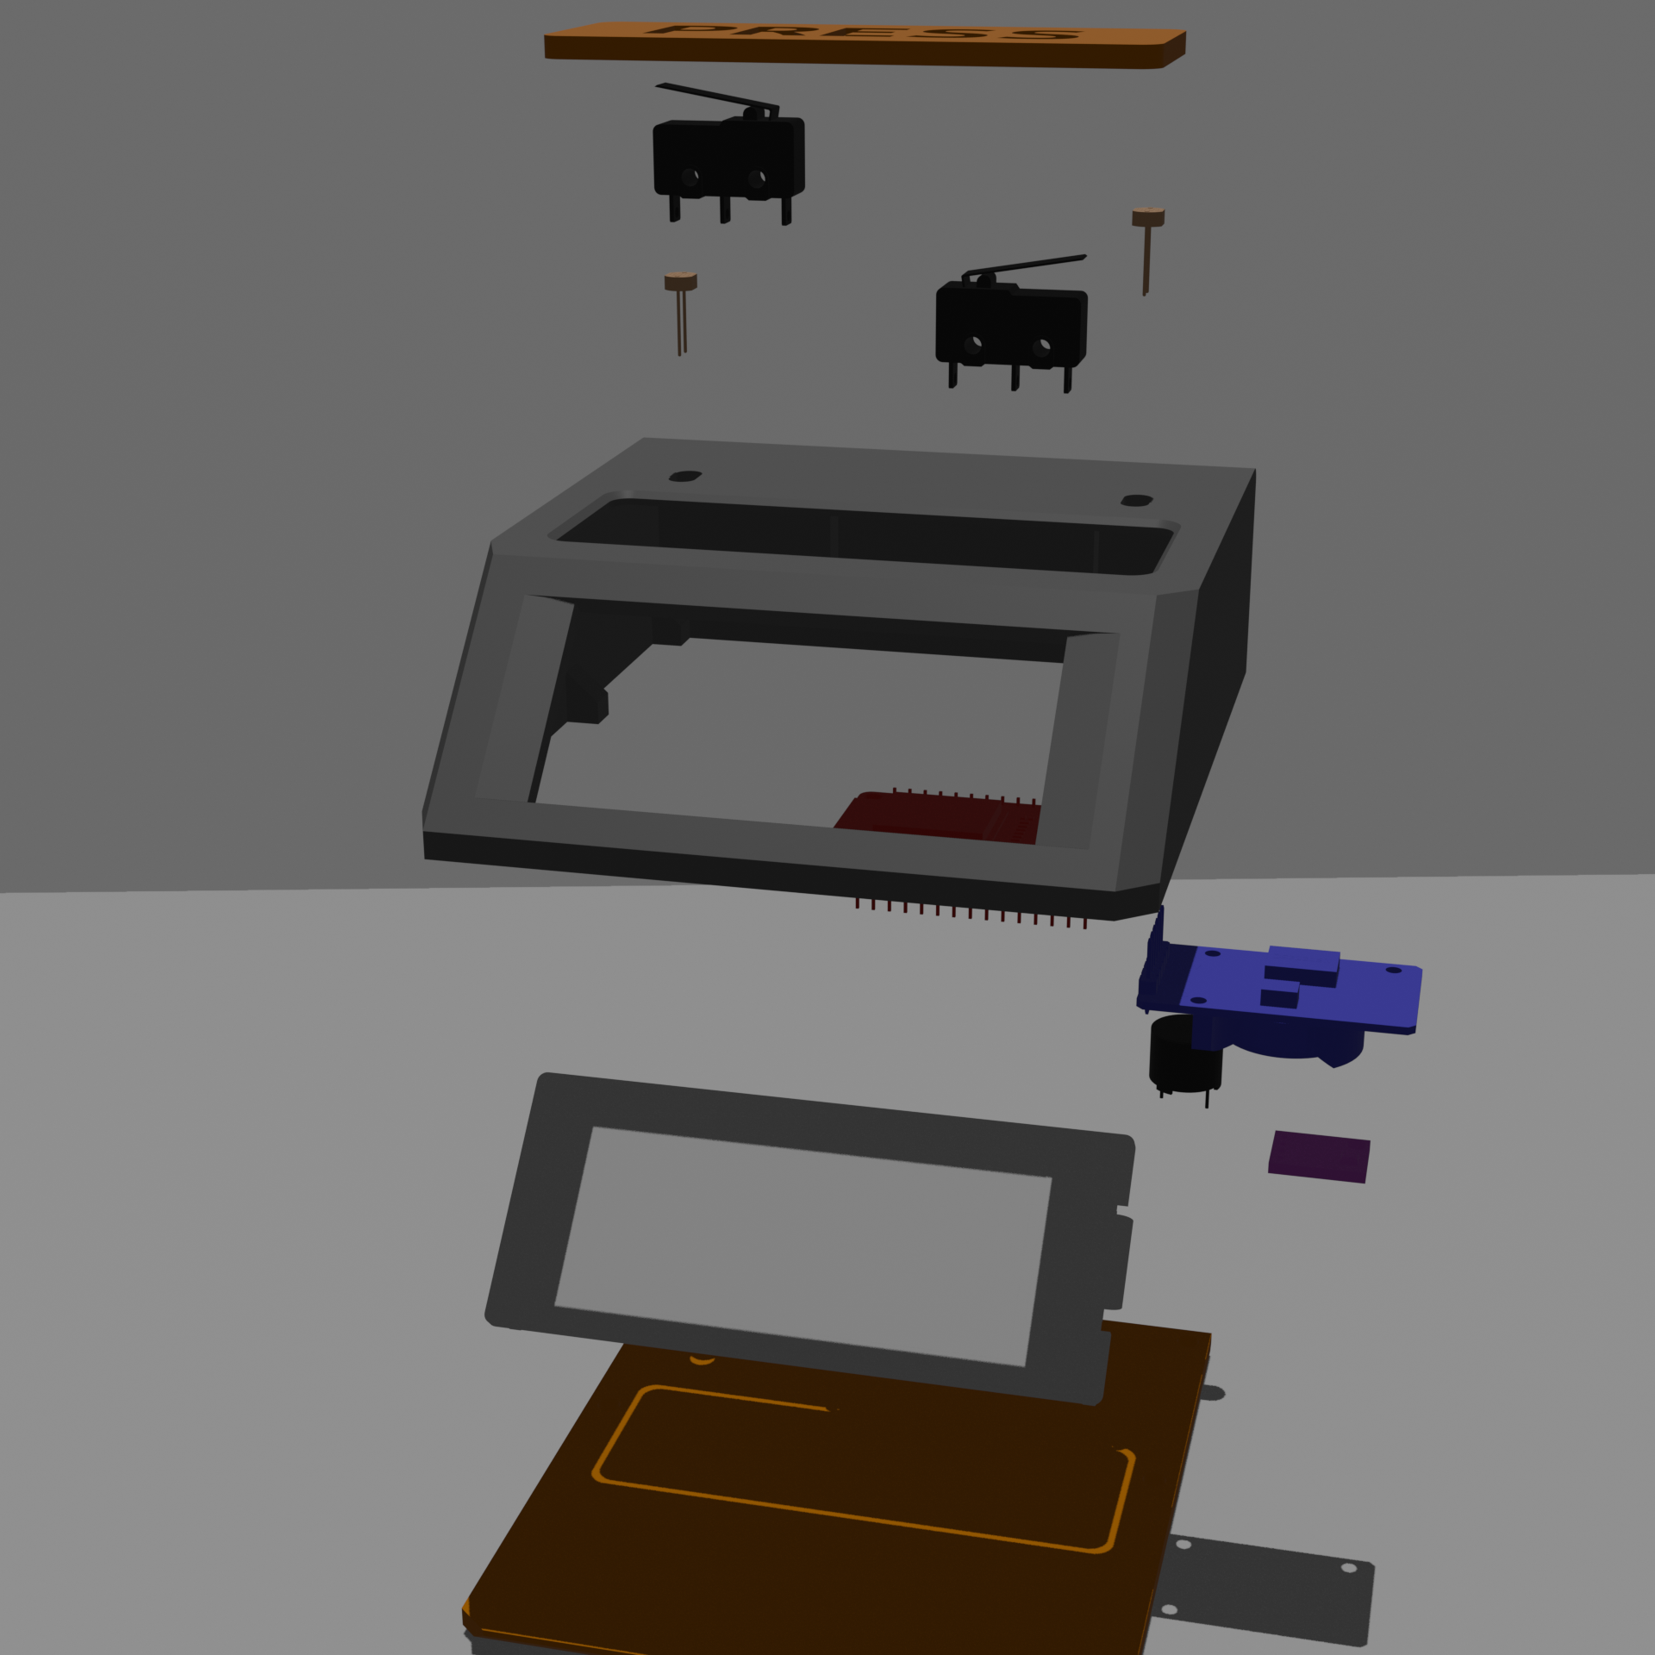

Slide 12
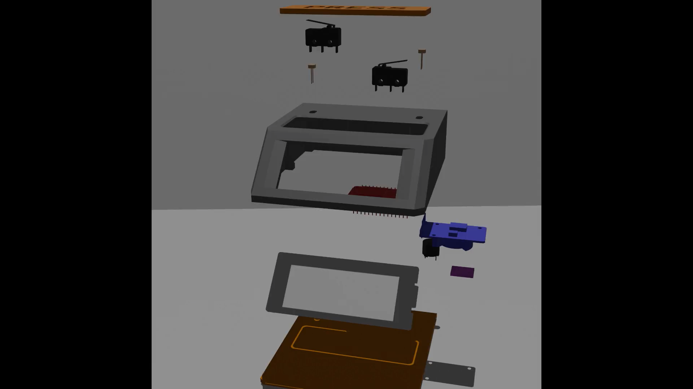
Notes:
Design of h/w In 3 places

Slide 13
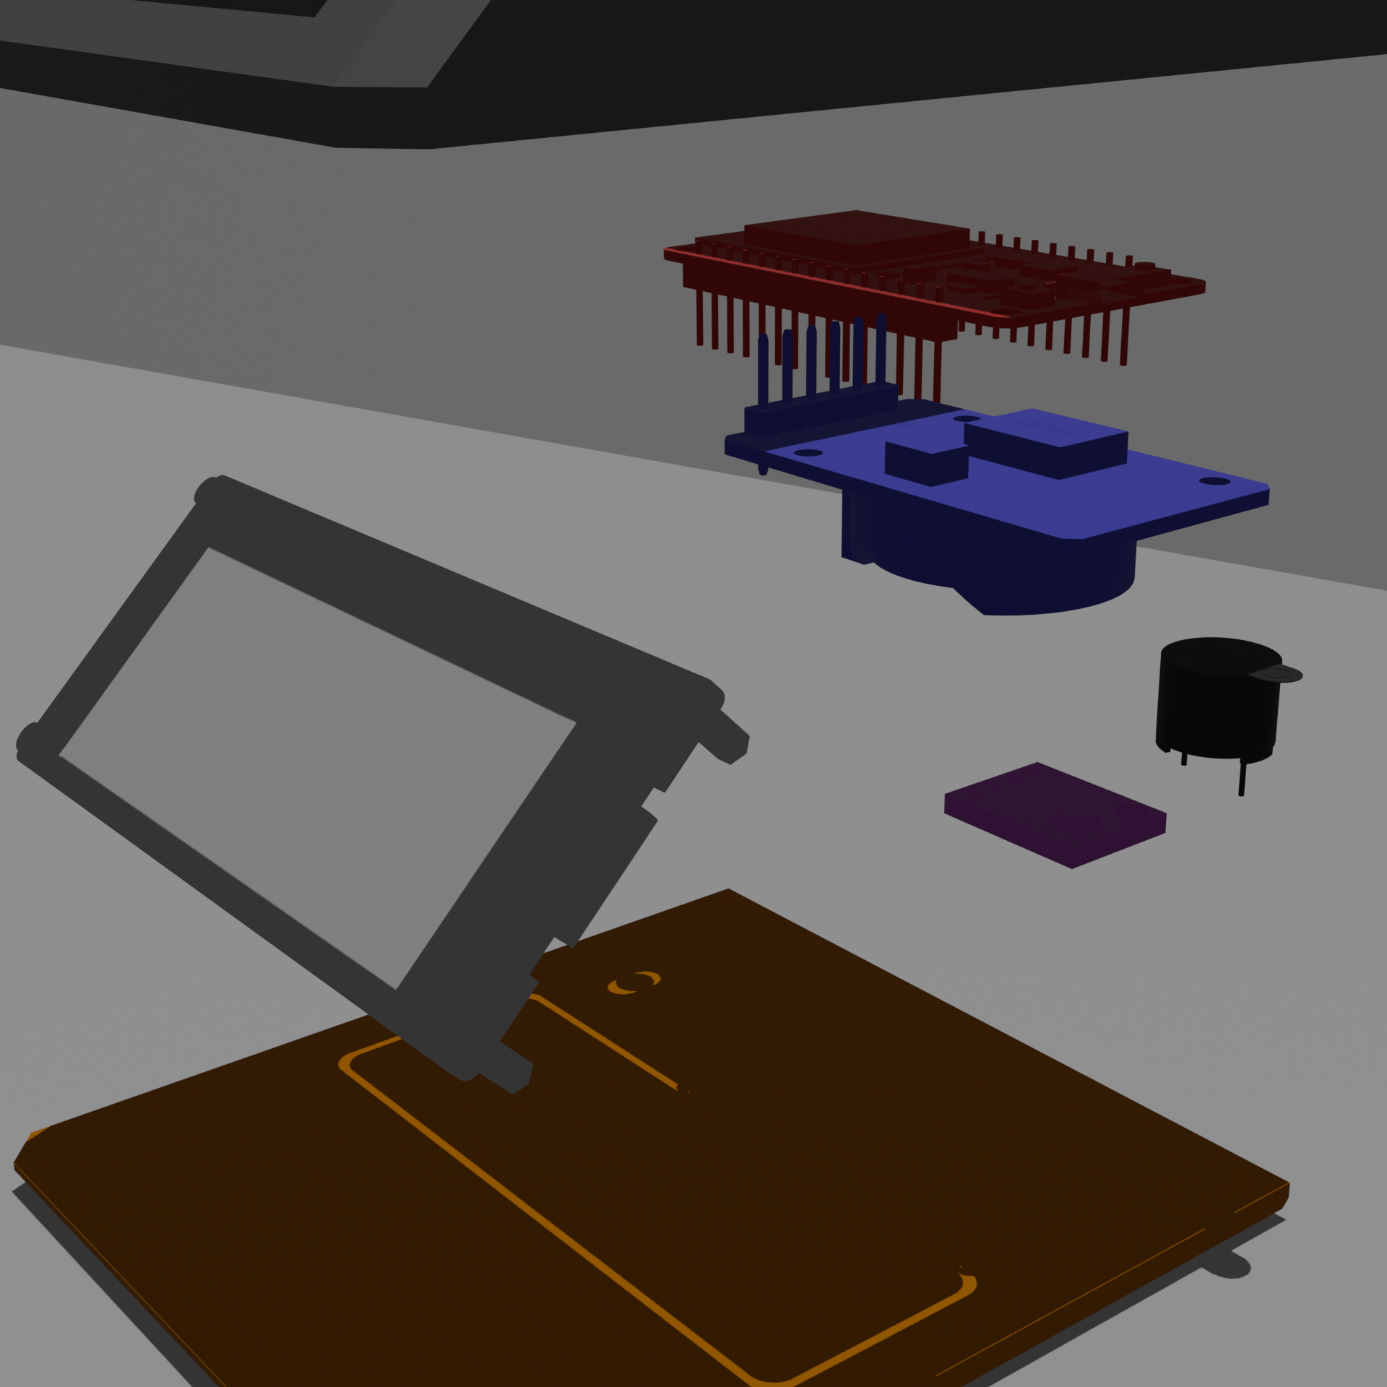
2.9 inch
E-ink display
By Waveshare
Notes:
Communication protocol

Slide 14
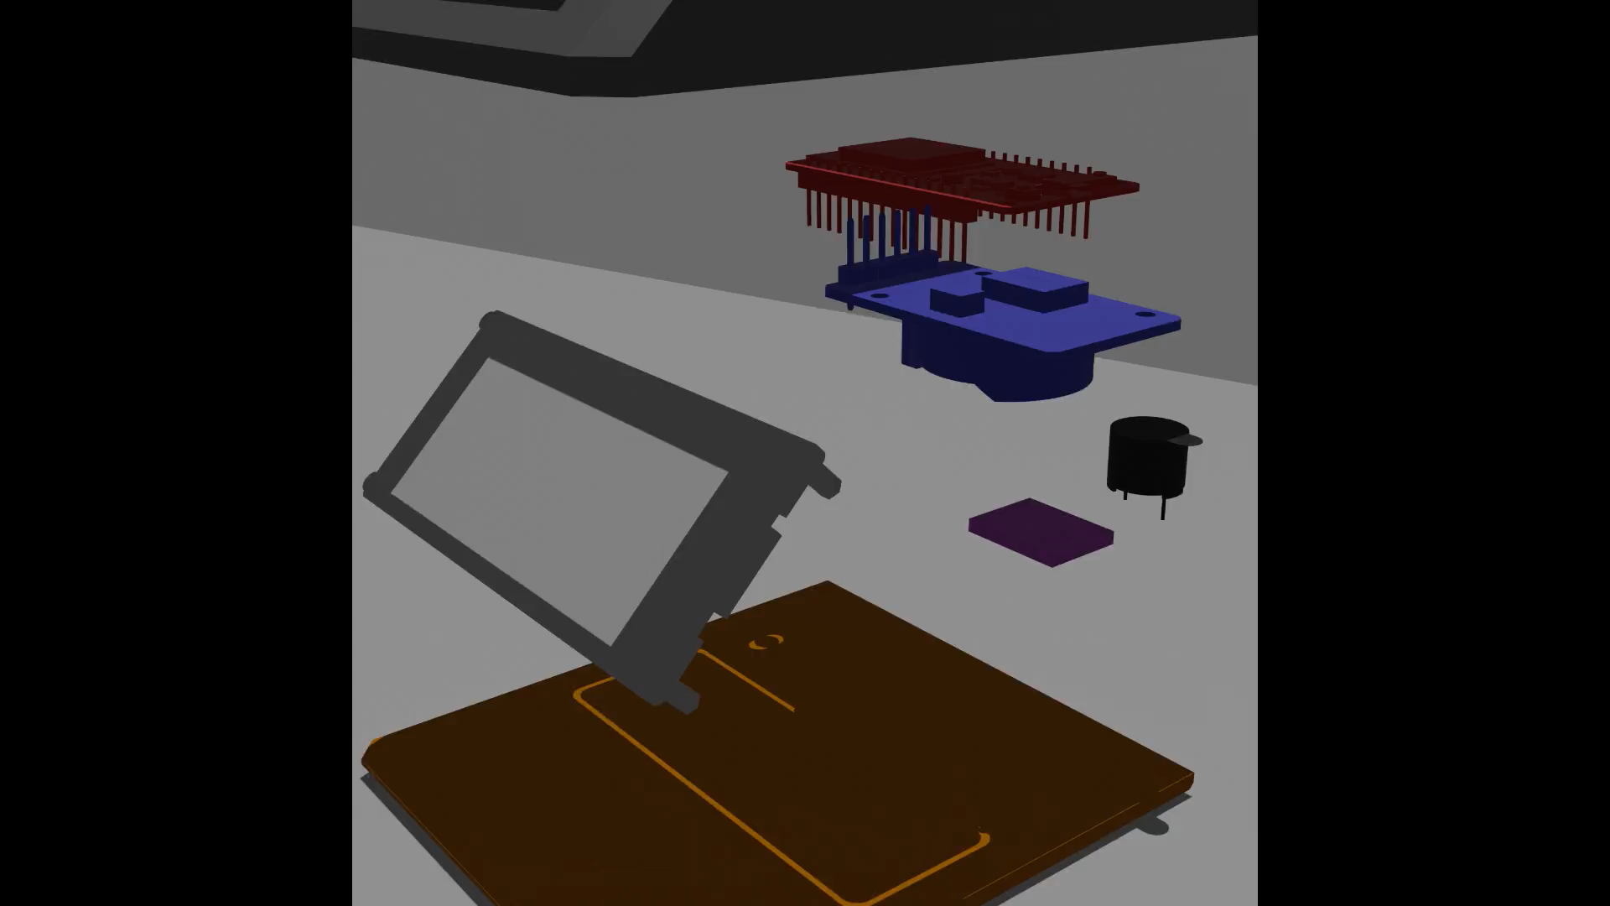

Slide 15
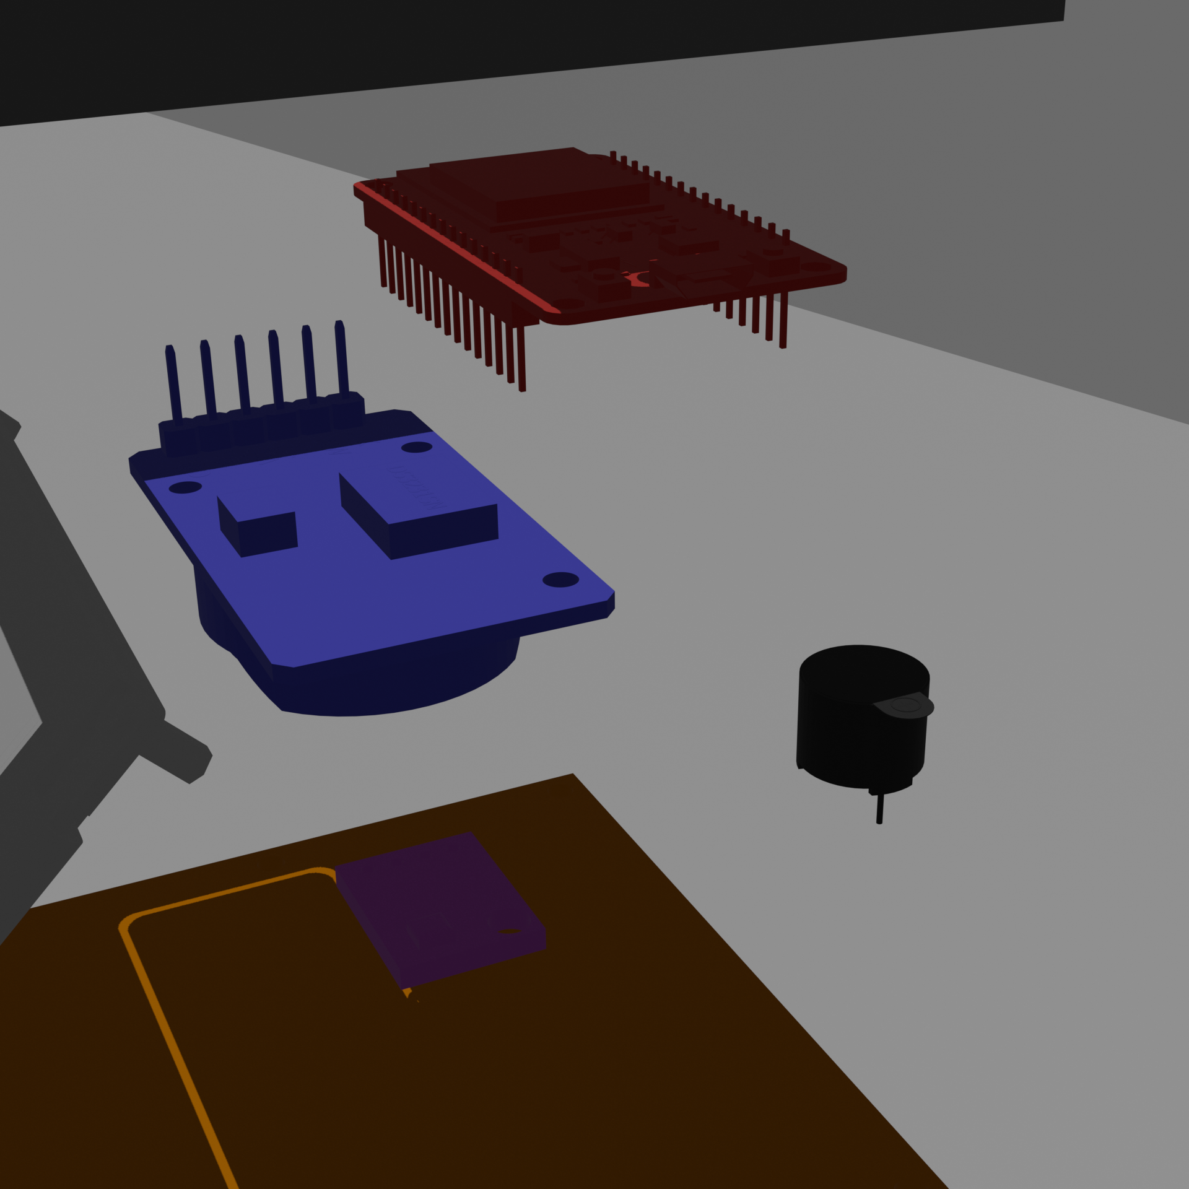
Real Time Clock module
ESP32
By olimex
BME280 sensor for temperature, pressure, humidity
5v buzzer
Notes:
Talk about communication protocols

Slide 16
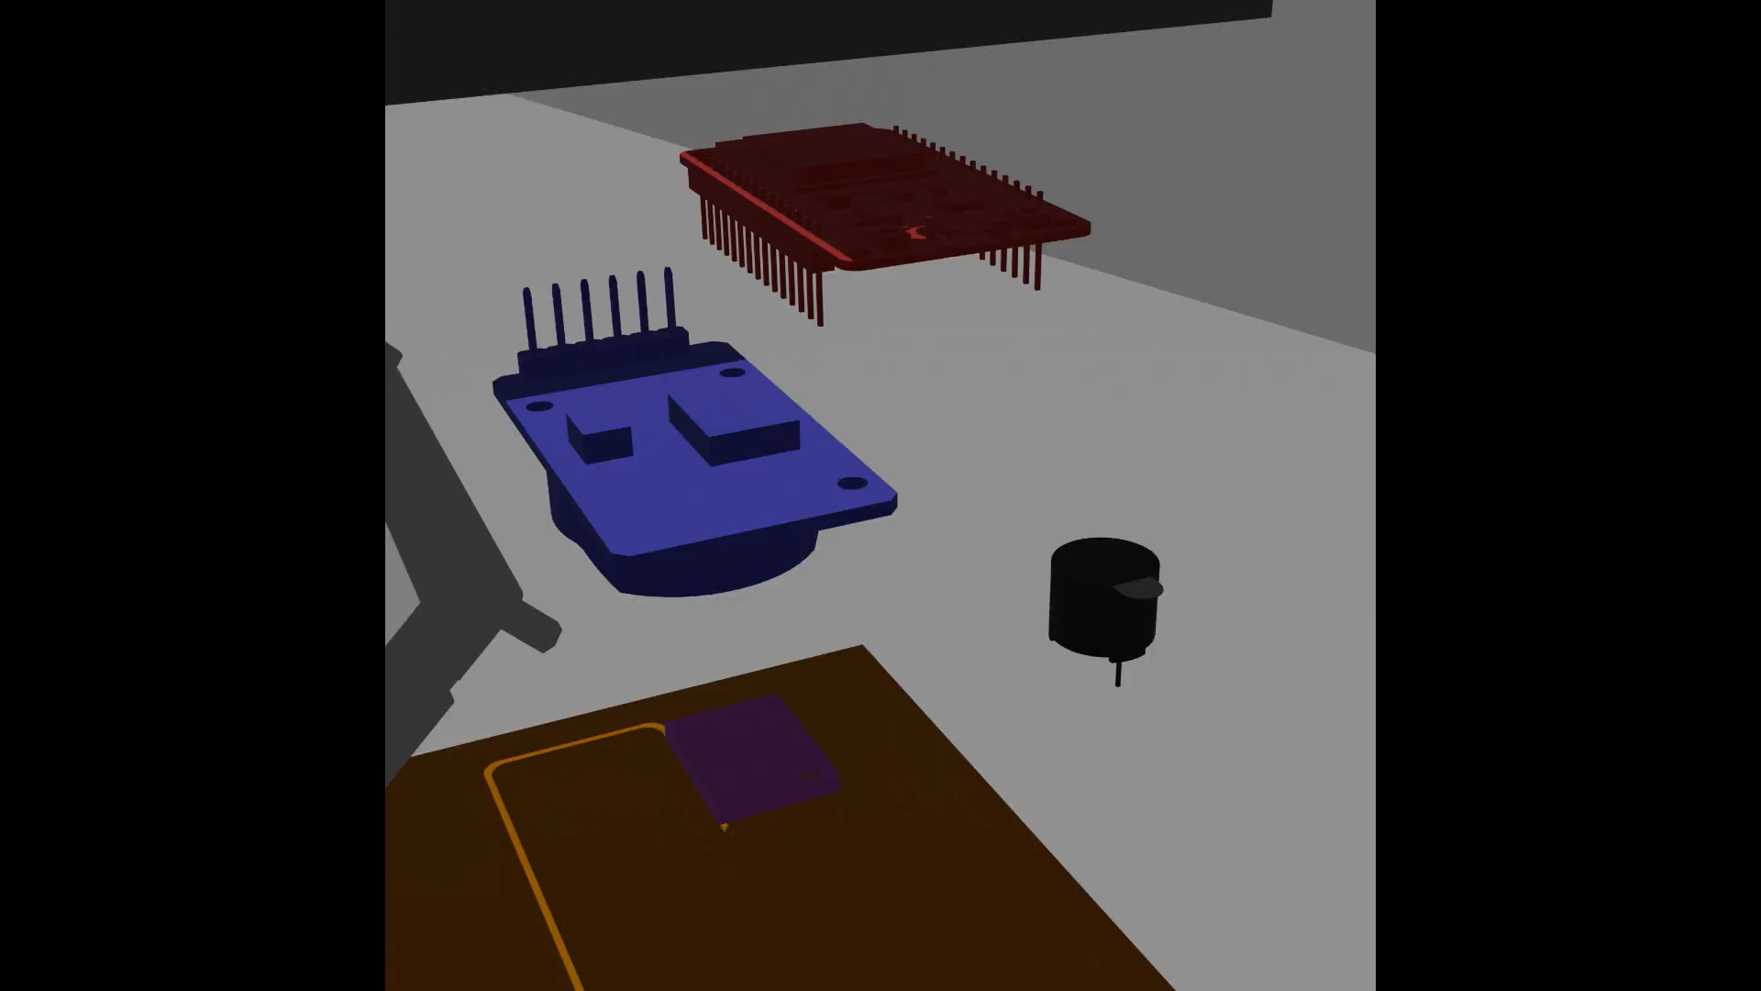

Slide 17
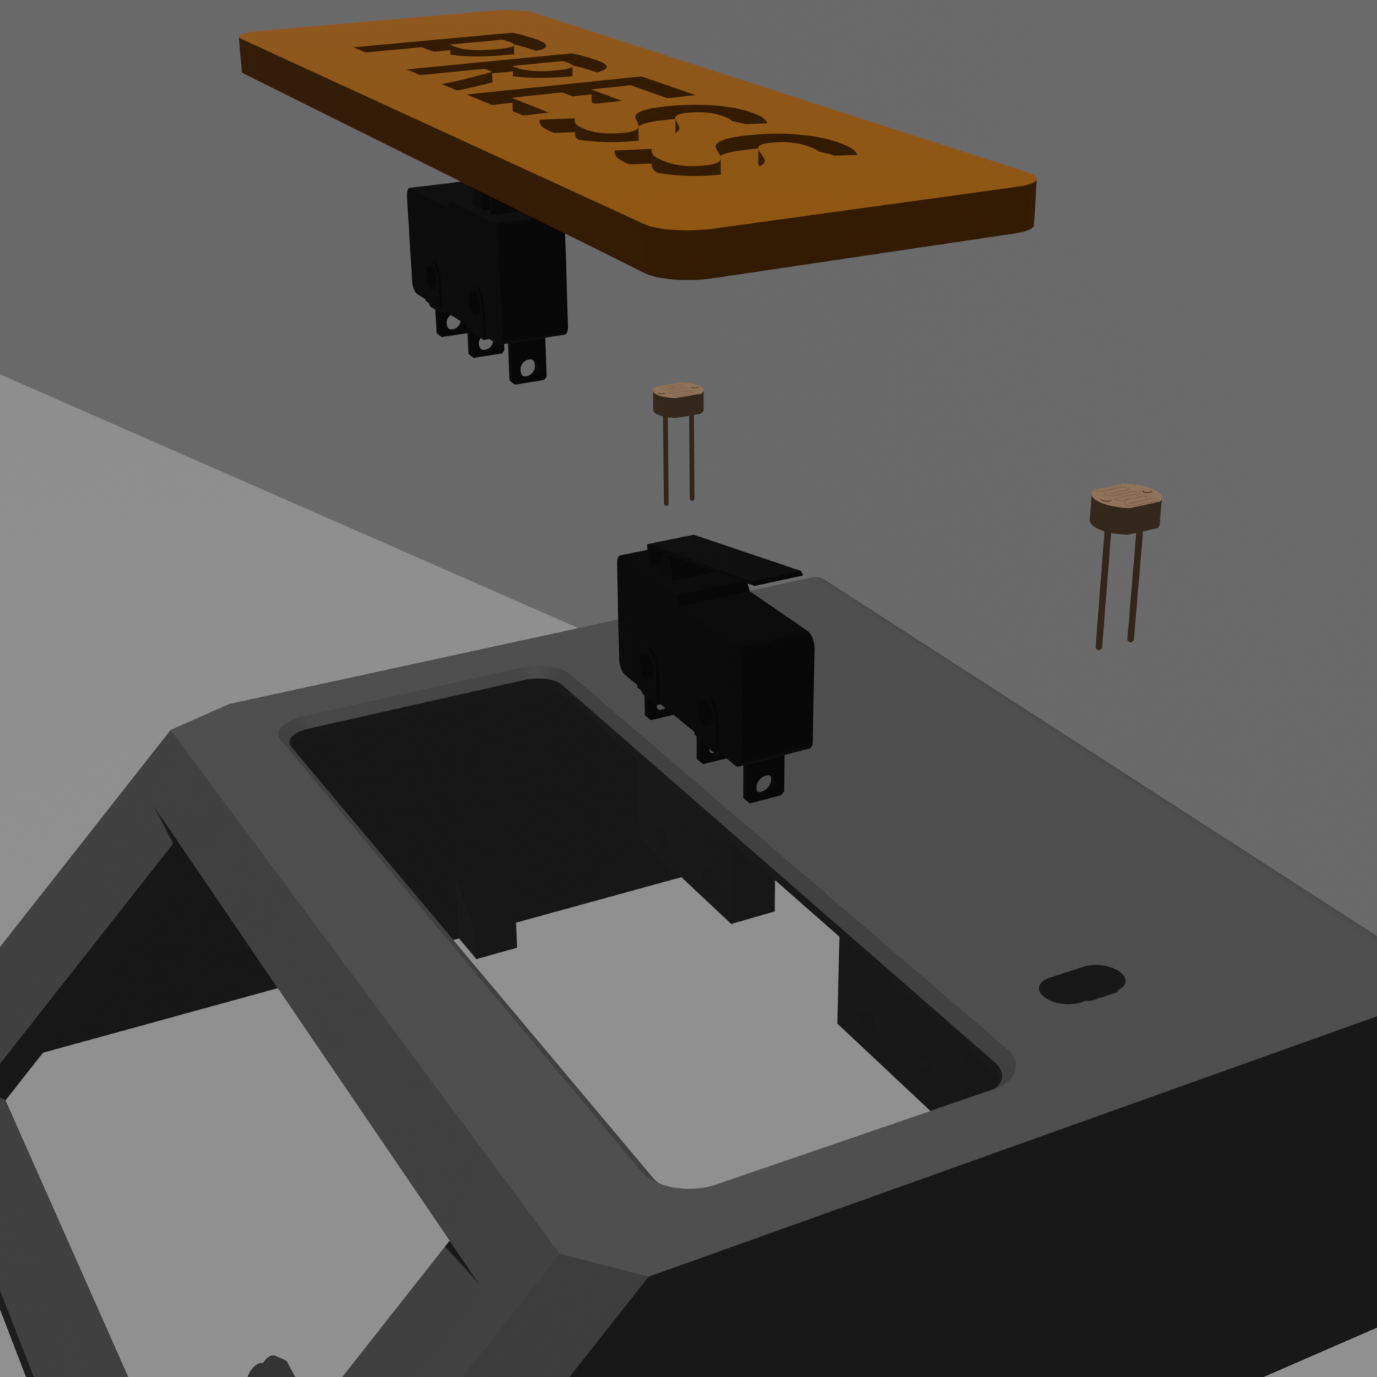
Photoresistors
Switches

Slide 18
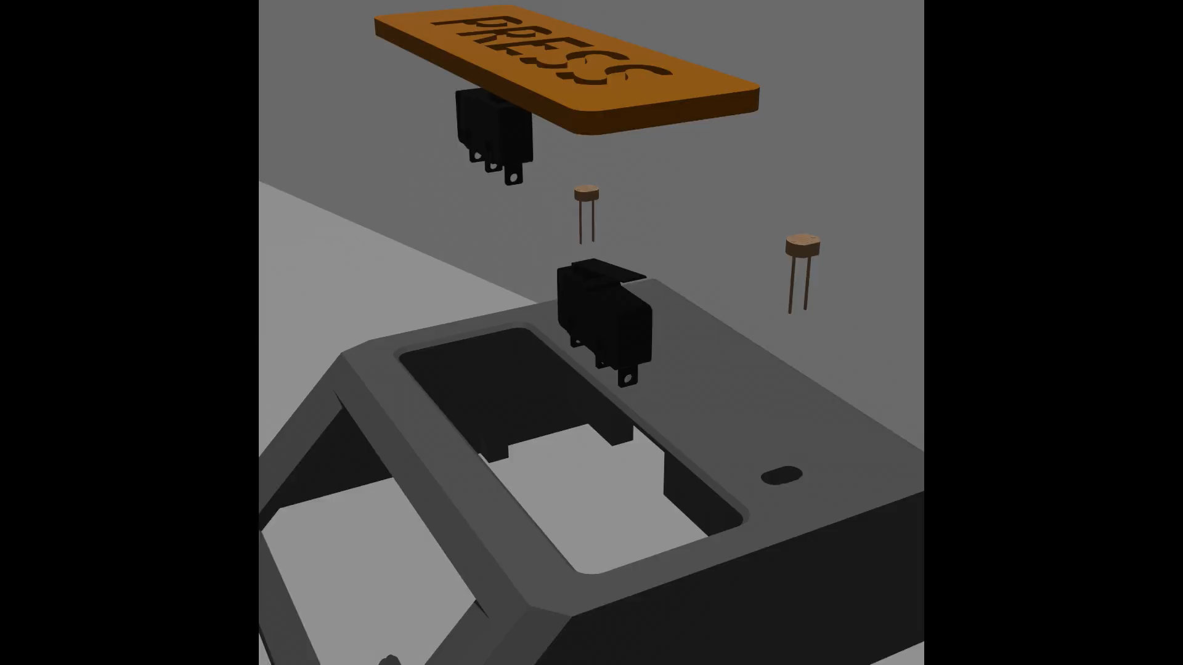

Slide 19
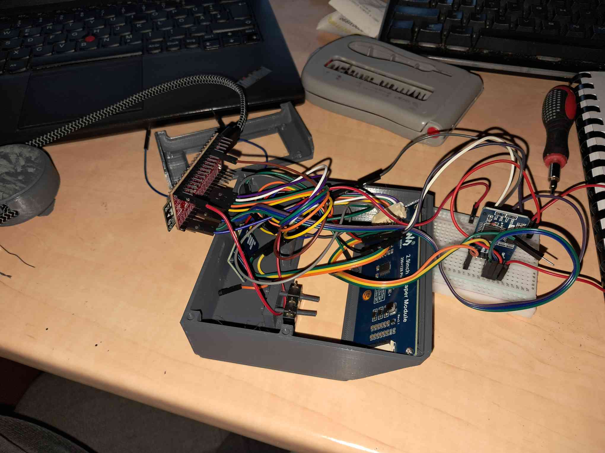

Slide 20
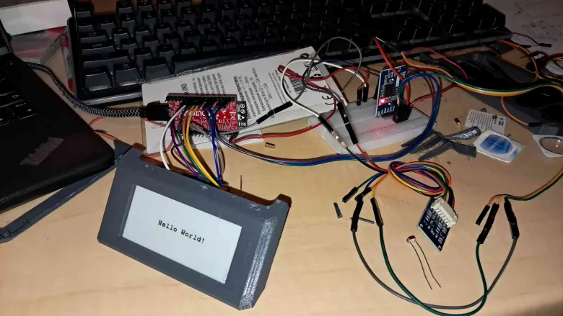

Slide 21
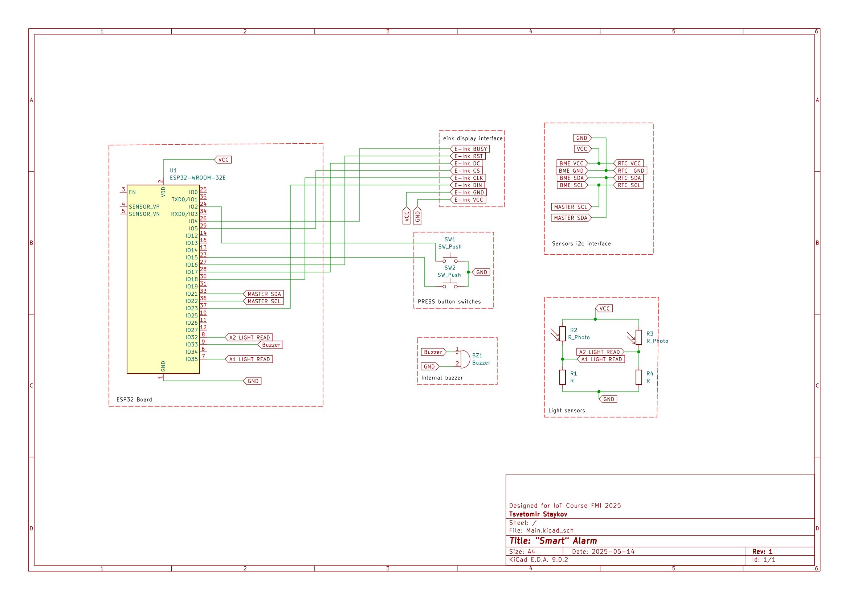

Slide 23
Original list of components:
ESP 32
Switches
Photoresistors
BME280 sensor
RTC module
/ 7 segment display
E-ink display 2.9 inch
Analog Microphone
Sd card reader
Speaker

Slide 24
Original list of components:
ESP 32
Switches
Photoresistors
BME280 sensor
RTC module
E-ink display 2.9 inch
/ 7 segment display
Analog Microphone
Sd card reader
Buzzer
Notes:
Sd card not added due to spi communication connection

Slide 25
RTCModule
Display
Display pages
Alarm
Environmental sensors
Logic
Main
Libraries
Logger
Software
api
pins
Wifi
WebPage
Weather

Slide 26
RTCModule
Display
Display pages
Alarm
Environmental sensors
Main stuff
Logic
Main
Libraries
Logger
api
pins
Wifi
WebPage
Weather

Slide 27
Main stuff
Other main stuff
Logic
RTCModule
Main
Display
Libraries
Logger
Display pages
api
pins
Wifi
Alarm
WebPage
Environmental sensors
Weather

Slide 28
Main stuff
Other main stuff
Logic
RTCModule
Main
Display
Libraries
Logger
Display pages
api
pins
Wifi
Alarm
WebPage
Environmental sensors
Weather
wifi stuff

Slide 29
Main stuff
Other main stuff
Logic
more stuff
RTCModule
Main
Logger
Display
Libraries
Display pages
api
Alarm
pins
Wifi
WebPage
Environmental sensors
Weather
wifi stuff

Slide 30
Module and sensor control
Logic and initial
Logic
Support libraries
RTCModule
Main
Logger
Display
Libraries
Display pages
api
Alarm
pins
Wifi
WebPage
Environmental sensors
Weather
Wifi stack

Slide 31
Module and sensor control
Logic and initial
Logic
Support libraries
RTCModule
Main
Logger
Display
Libraries
Display pages
api
Alarm
pins
Wifi
WebPage
Environmental sensors
Weather
Wifi stack

Slide 32
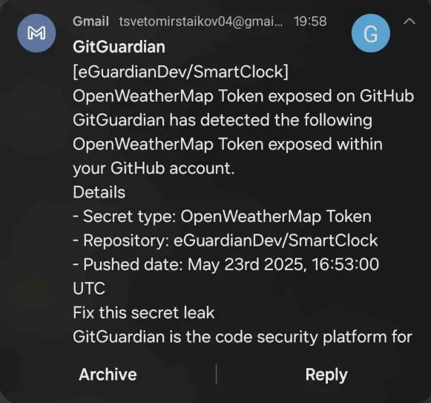

Slide 33
Module and sensor control
Logic and initial
Logic
Support libraries
RTCModule
Main
Logger
Display
Libraries
Display pages
api
Alarm
pins
Wifi
WebPage
Environmental sensors
Weather
Wifi stack

Slide 34
Logic
RTCModule
Main
Display
Logger
Display pages
Alarm
Environmental sensors
Libraries
Wifi
api
WebPage
pins
Weather

Slide 35
Code architecture style:
Custom, event based, side effects
Also known as:
BAD CODE
There are too many public variables, please don’t do this. Use normal event based programming and don’t use side effects, it gets really confusing.

Slide 36
Setup
Init pins
Init libraires
Get Wifi ready
Main loop
Check for updates
Update global variables
Check if any changed are needed

Slide 37
Setup
Init pins
Init libraires
Get Wifi ready
Setup subscriptions
Main loop
Check for updates
Call functions
If updates present
Also eliminate global variables

Slide 38
Libraries:
RTClib - real time clock
Adafruit BME280
GxEPD2 - e-ink display
Wifi provisioner
Preferences - simpler eeprom configuration
ESPmDNF
Arduino JSON - simpler api readings

Slide 39
Demo

Slide 40
Possible future developments:
Custom PCB Design
Better hardware box
Change to better event base system
Add missing electronics components
Add analytics
Add link with google (tasks, calendar, bus routes)
Battery
Sleep mode – stop Wifi, longer refresh time, etc.
Hand and light detection
Make it fly
Update esp32 to Quantum computer

Slide 41


Used tools to make the project
Photopea
Bitmap editing
OpenWeatherMap API

Slide 42



Used tools to make the project
Photopea
Bitmap editing
Blender
animation
OpenWeatherMap API
KiCAD
electronics schematics
FreeCAD
Box design

Slide 43
Thank you for your attention!
Questions?

Slide 44
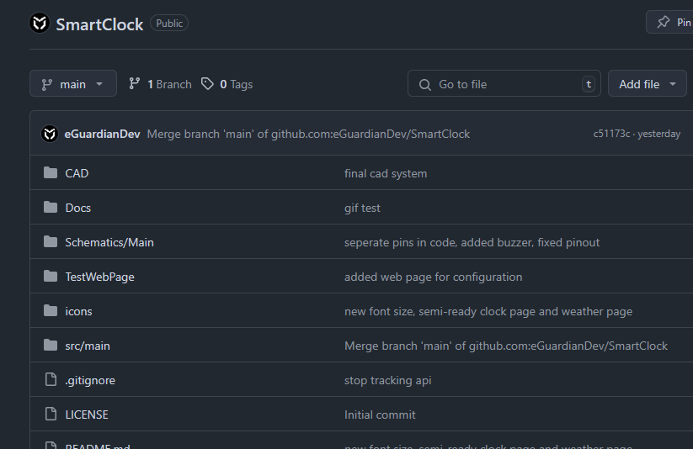
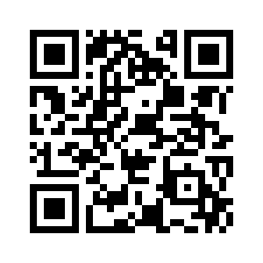
github.com -> eGuardianDev -> SmartClock

